Slide 1
超越学科界限的认知基础 Transdisciplinary Cognitive Foundation Namespace Management Week 2
Ben Koo
September 22, 2021

Slide 2


Names gave birth to Cognitive Abilities - Laozi
Huawei VP Mr. Yang Shaoqing
RICH 70 Tsinghua SEA Cloud Forum, Sep 14, 2020
H. E. Bambang Brodjonegoro,
Minister of Research & Technology, Indonesia

Slide 3
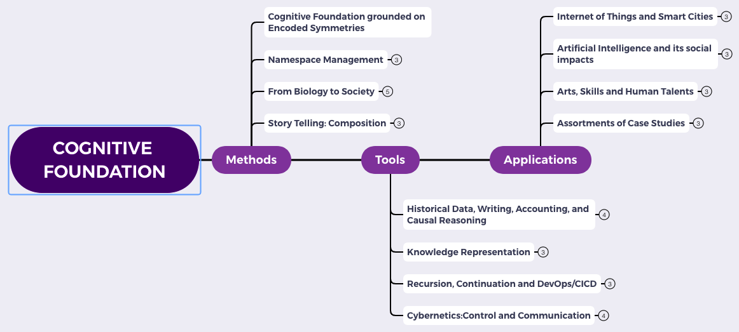
Content Themes for the semester
Overview
Namespace Management
Biology, Physics, Math, Code is Law, and Society
Story Telling, Functions/Metaphors/Analogies
Writing, Accounting, Historical Data and Temporal Reasoning
Knowledge Representation in Wiki and Files
Recursion and Continuation (DevOps/CICD)
Midterm Reports by Students
Cybernetics (Control and Communication)
Smart City and Internet of Things
Artificial Intelligence and its Social Impacts
Arts/Skills/Human Talents in the Digital Era
Student proposed Application Topics
Rehearsal
Final Reports and Celebration

Slide 4
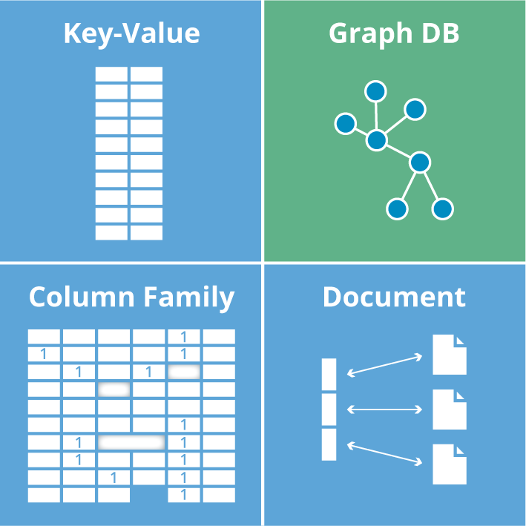
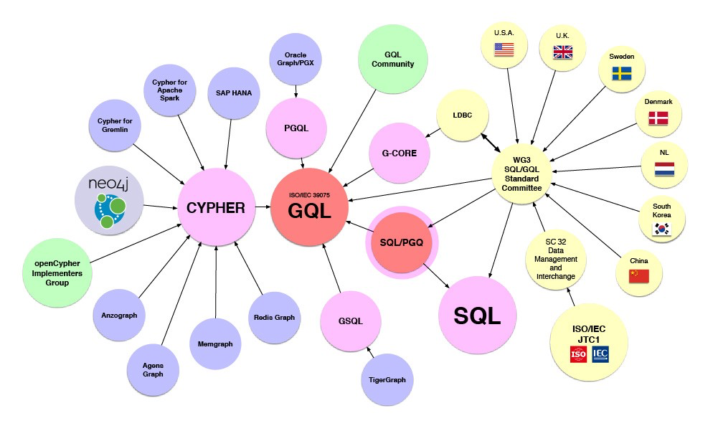








Encoded Symmetries in the IT industry
Image source: Graph Database for Beginners by Neo4j

Slide 5
Universal Data Abstraction
Cognitive Effectiveness can be enhanced by
a Unifying Data Abstraction

Slide 6
Key-Value Data Type is a Universal Abstraction
Mapped Domains | key/value | Examples
data/data | Inputs/Outputs | Dictionary/Tabulated Data
structure/structure | algorithm/source code | Logical Structures/Functions in Software Libraries
language/language | Specification/Implementation | Source Code/Executable Binary
Notes:
Soundness (Aliveness vs Safety = Correctness)
Precision (The result has a outer boundary)
Termination (It will come to completion)

Slide 7
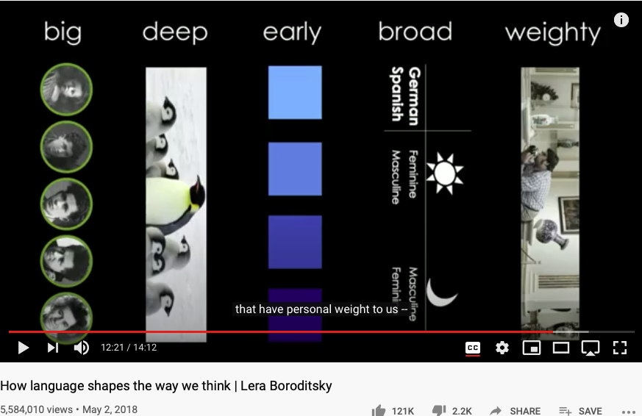
Namespaces governs Cognitive Capacity
Huawei VP Mr. Yang Shaoqing
https://youtu.be/RKK7wGAYP6k

Slide 8
The Notion of Closure and Symmetry-breakinig
Normal Science
Model
Drift
Model Crisis
Model Revolution
Paradigm
Change
Emerging cases or
systematic attacks

Slide 9
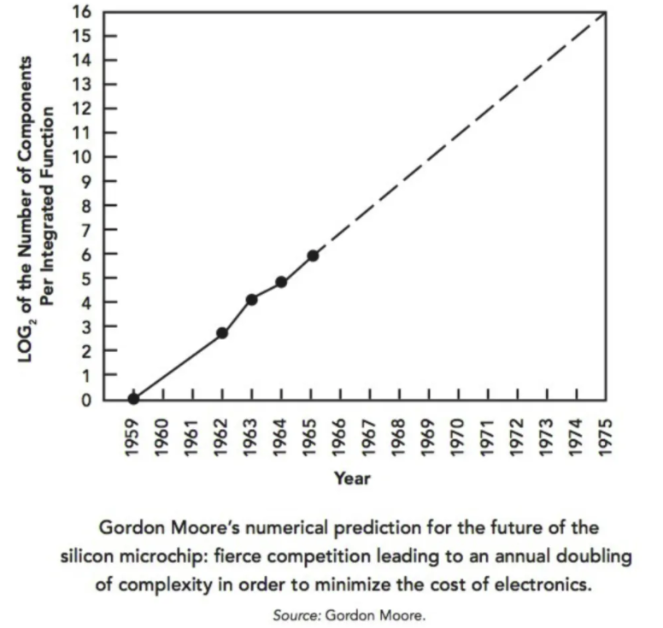
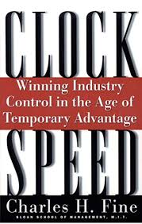
The Role of History and Symmetry-breakinig
Normal Science
Model
Drift
Model Crisis
Model Revolution
Paradigm
Change
Emerging cases or
systematic attacks

Slide 10
The notion of Incommensurability
A notion of Representables
A cognitive model integrated by
Category Theory
Approximation as a part of Representational Artifacts

Slide 11
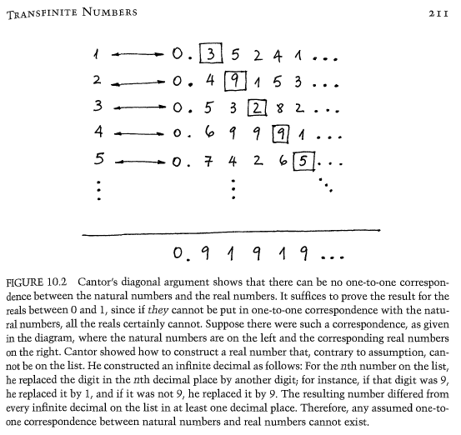
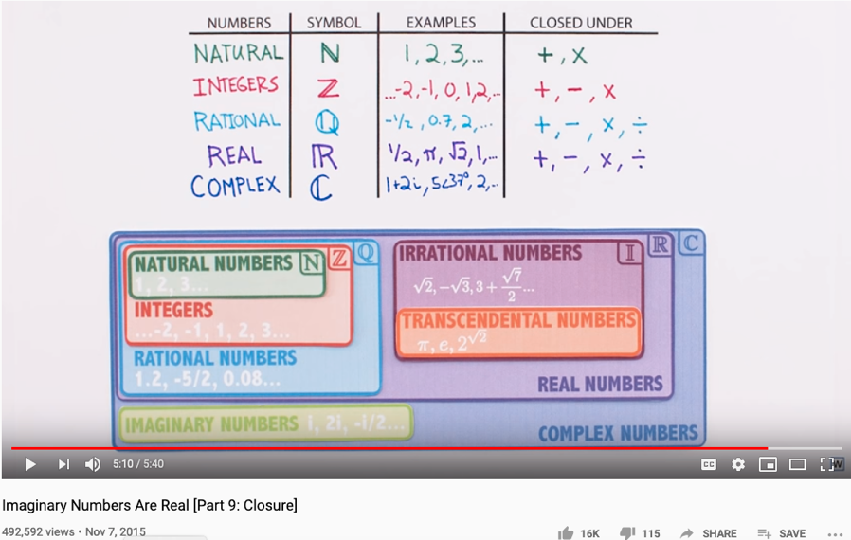
The Complete set of Generative Names
Huawei VP Mr. Yang Shaoqing

Slide 12

Arts and Sciences of NsM
History of Names
Patterns of Names
Trust-worthy Names
Namespace management is the Cognitive Foundation.

Slide 13
Thinking in Math = Acting in Namespaces
Huawei VP Mr. Yang Shaoqing
Mathematics is the art of giving the same name to different things.^{[10]} Henri Poincaré
Bertrand Russell’s Principles of Mathematics on “Doctrine of Types”
The way to write and organize names becomes the essence.
What methods and tools can be helpful?
RICH 70 Tsinghua SEA Cloud Forum, Sep 14, 2020
H. E. Bambang Brodjonegoro,
Minister of Research & Technology, Indonesia

Slide 14
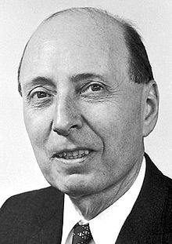
The Miracle of Math in Natural Science
"The Unreasonable Effectiveness of Mathematics in the Natural Sciences" is the title of an article published in 1960 by the physicist Eugene Wigner.^{[1]}
It is all about Name Space Management
Namespace can be compressed
It allows effective representation of both spacetime structures
Link to the original text: http://www.dartmouth.edu/~matc/MathDrama/reading/Wigner.html

Slide 15
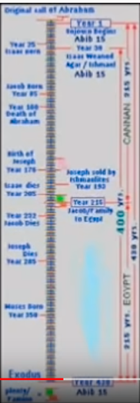
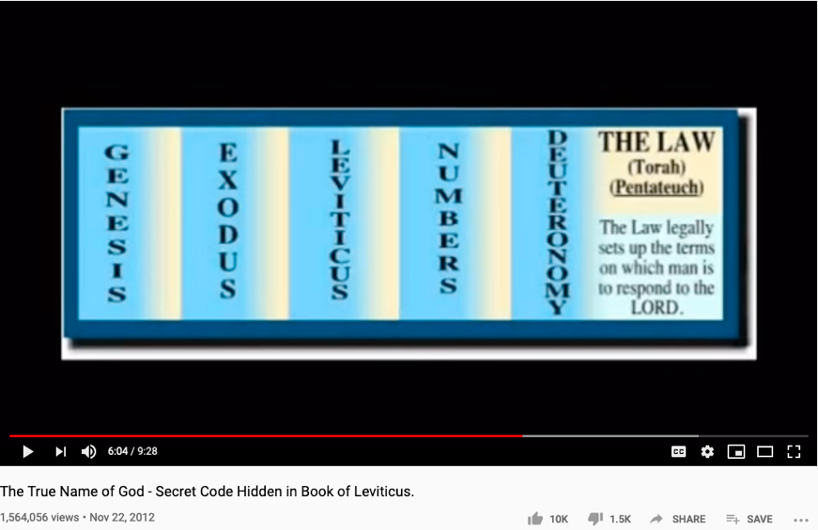
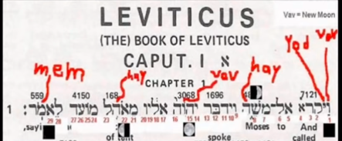
The History of True Names
Huawei VP Mr. Yang Shaoqing
RICH 70 Tsinghua SEA Cloud Forum, Sep 14, 2020
H. E. Bambang Brodjonegoro,
Minister of Research & Technology, Indonesia
How Gods are forgotten:
https://youtu.be/xgyMY9w7-ew?t=278

Slide 16
Universal Representation
Huawei VP Mr. Yang Shaoqing
RICH 70 Tsinghua SEA Cloud Forum, Sep 14, 2020
H. E. Bambang Brodjonegoro,
Minister of Research & Technology, Indonesia

Slide 17
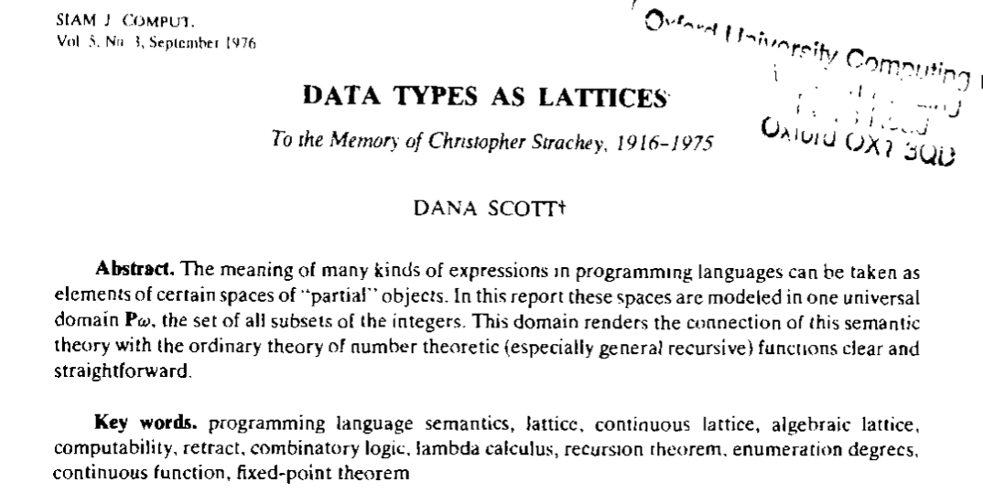
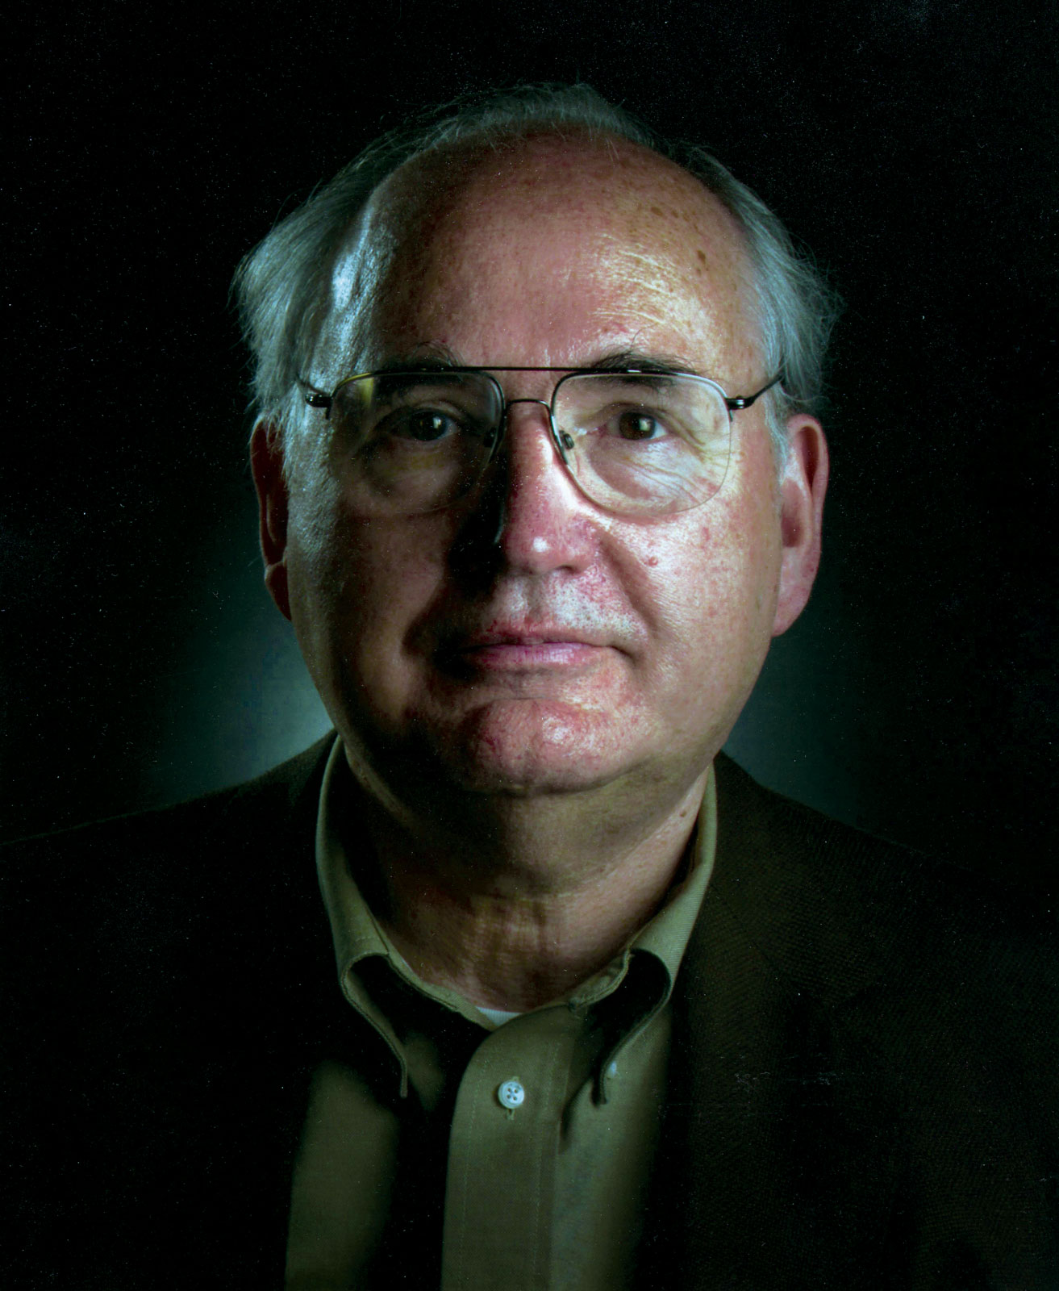
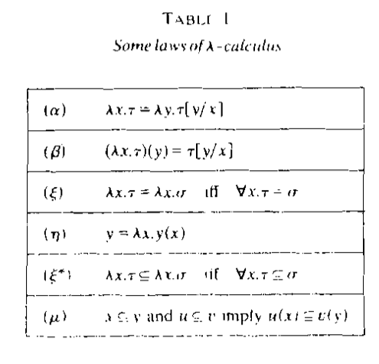


All meaningful expressions can be modeled as $𝒫ω$
Key
Value
Prof. Dana Stewart Scott
Hyperlink
Image Source: Britannica
why directed link is a form of universal data abstraction

Slide 18
In Pure Computation: Function is the ONLY thing.
Primitive Func
Func1
Func2
𝜆
fVar
Func(fVar…)
( )
Functions

Slide 19
The Universal Structure in 𝜆-Calculus Form
Expression := Contextualized Data (* Known interpretation results, no computation *)
| Goal_Exp Criteria_Exp (* Timeless and Time-based expressions *)
| 𝜆 Input Output_Exp(Input) (* A Computing Process *)
| ( Exception_Handling ) (* Stated boundary conditions/Exceptions *)
This set of rules can be used recursively to generate an infinite amount of expressions.
What
Contextualized data
Goal Expr
Criteria Expr
Why
𝜆
Input
Output Spec
How
( )
Exception Handling

Slide 20
A Logic Model is a Function
Context: Describe the Spatial and Temporal boundaries of the project.
Abstract Specification
Goal: Mission Statement written in an imperative sentence with reference to “Context”.
Measurable Effects: Conditional statements of the observable implementation outcomes that satisfy the “Goal”.
Concrete Implementation Process
Outputs
A list of noun phrases that declares the deliverable items from proposed activities
Activities
A structured set of actions that depicts implementation activities.
Ideally written in a formalized process specification language
Inputs
Prescribe the required resources to be consumed in the implementation Process
Boundary Conditions: When and how the boundaries of the previously defined ”Context” could be broken?

Slide 21
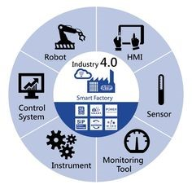
NsM at Scale!
Relations on the Web
URL: Universal Resource Locator
Universal Data Formats
Physical Objects connected through Namespaces

Slide 22

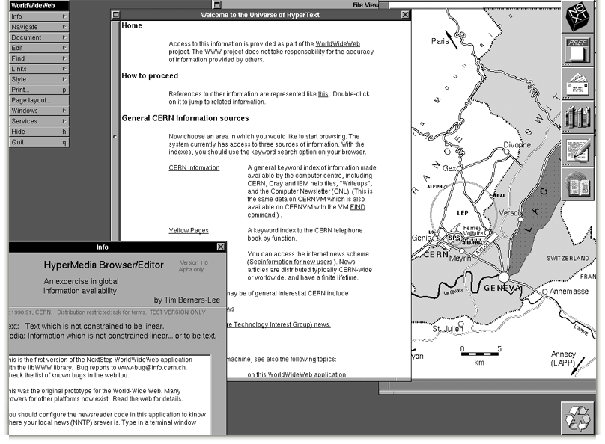
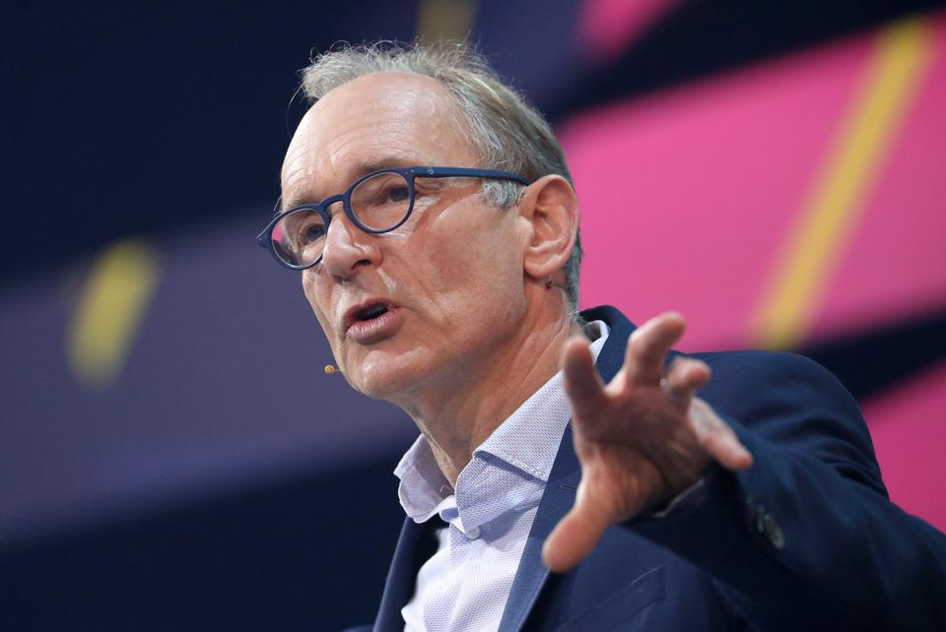


Namespace Management on the Global Scale
Berners-Lee called his vision for the web “utopian.”
He wanted it to be a place where all people had access to the best information at any time.

Slide 23
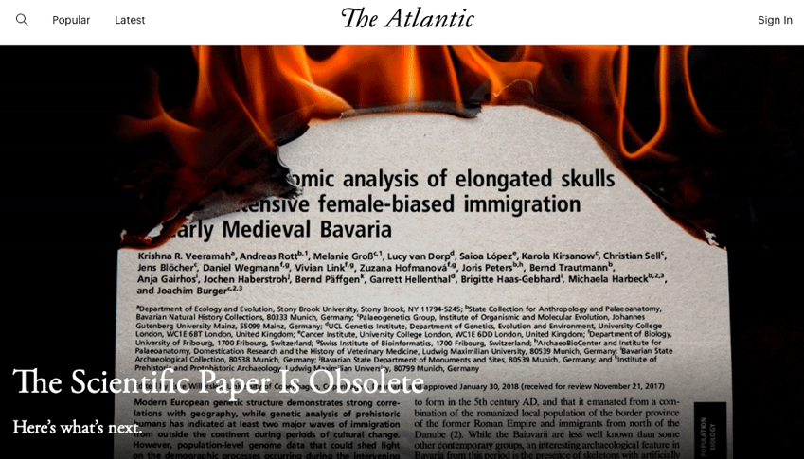
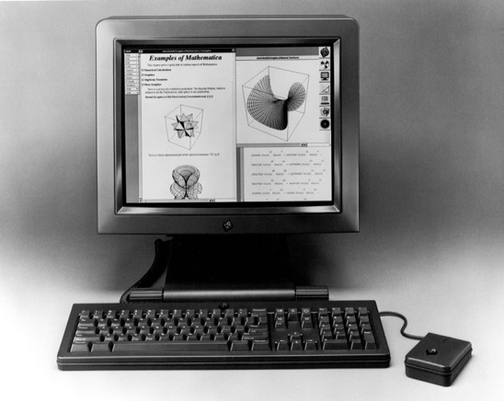
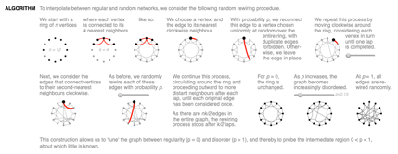
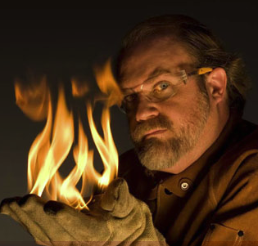
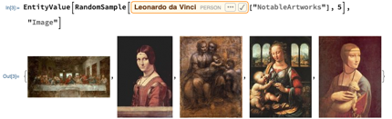
The origin and the Future of the “Web”
Theodore Gray created an Editable Interface for Computable Documents.
The technology is based on Mathematica, and was bundled with NeXT computers used by Berners-Lee.
Notes:
Wolfram|Alpha demo phrase
China's GDP over the sum of GDP of Japan and USA

Slide 24
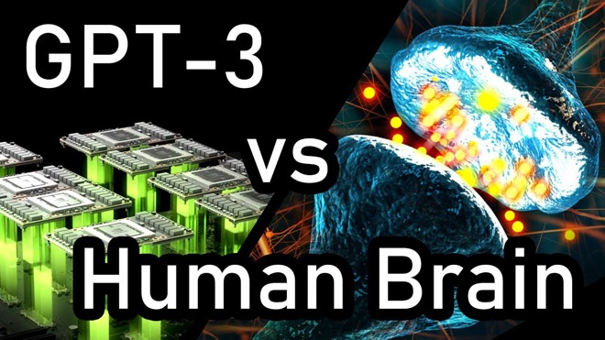

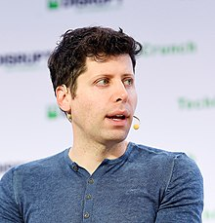
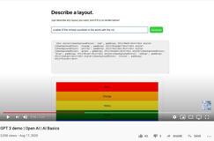
Namespace Management with Open AI
An “open” Artificial Intelligence resource that is available for “free”.
It will do your software development work for you for free, too.

Slide 25

Chinese Pre-Trained Neural Network
https://cpm.baai.ac.cn

Slide 26
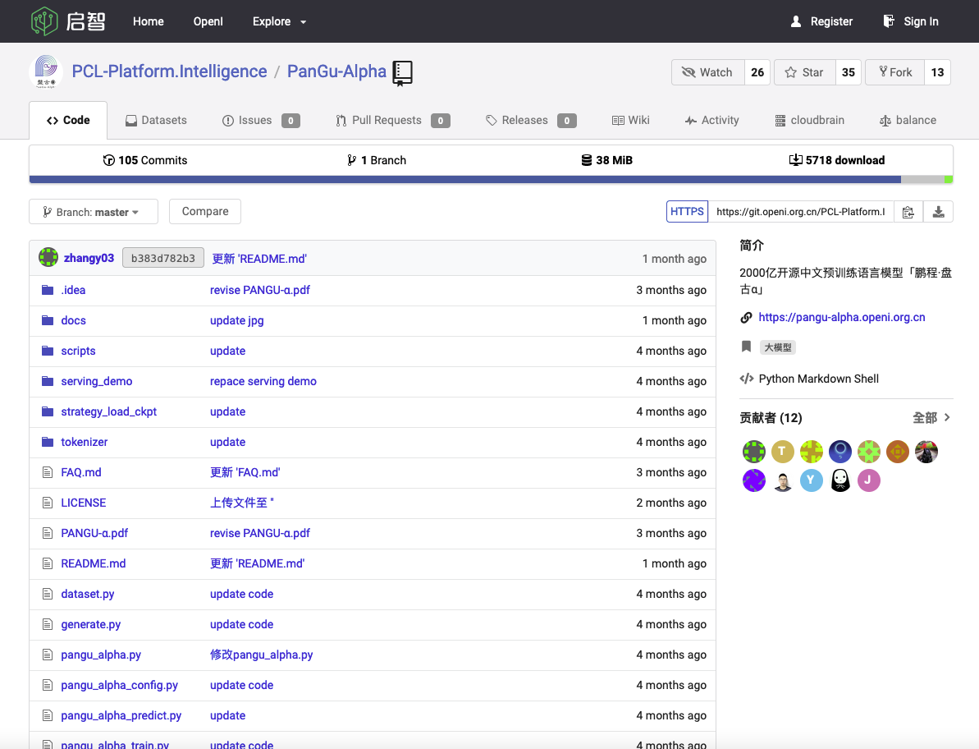
Another Chinese Pre-Trained Neural Network
https://git.openi.org.cn/PCL-Platform.Intelligence/PanGu-Alpha

Slide 27
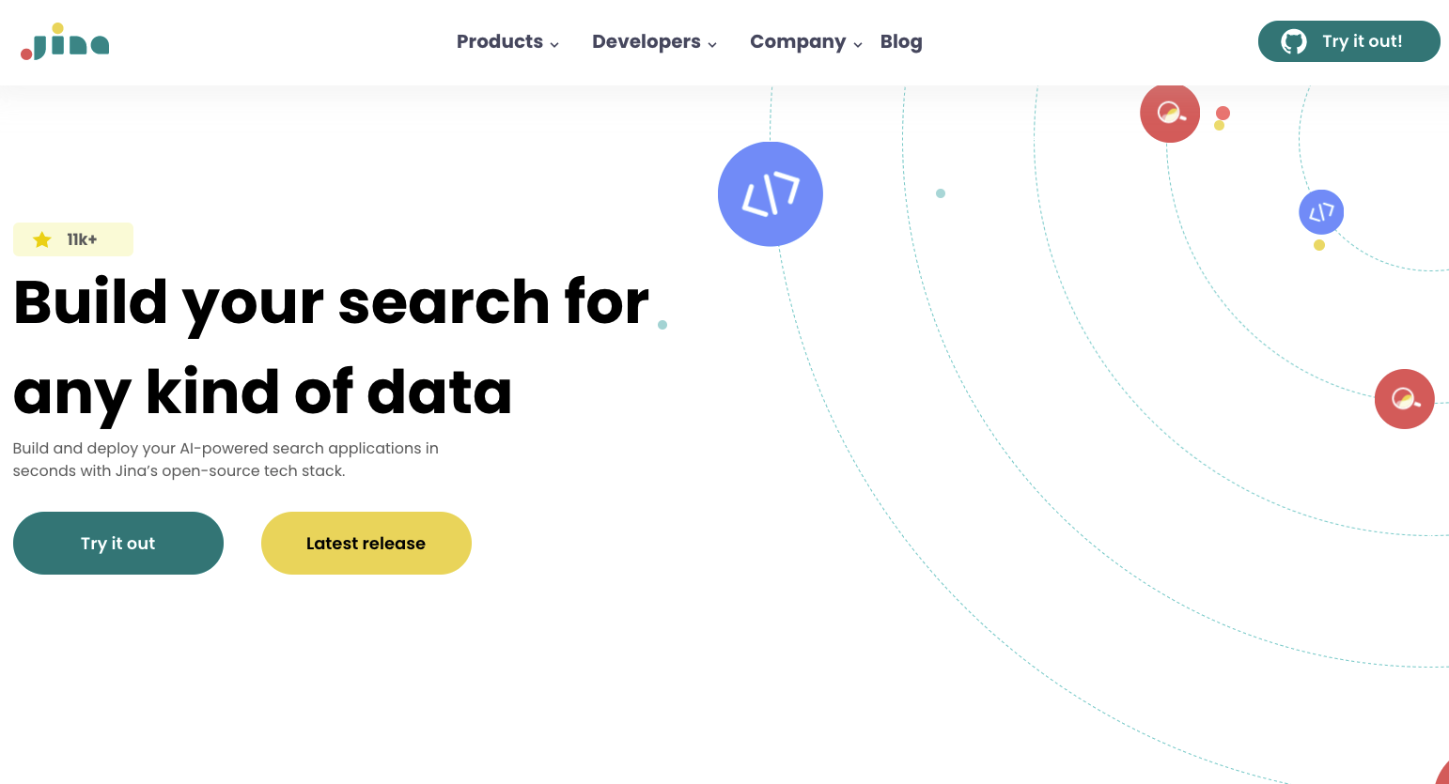
Another Neural Network Open Source Tool
https://jina.ai

Slide 28
Glossary
Terms related to Name Space Management:
Ontology/本体论: the philosophical study of being. (Wikipedia)
Epistemology/知识论: a theory of knowledge, (Standord Philosophy Encyclopedia)
Universal Resource Locator/Indicator(URL/URI) : a string representing global resources
NsM related Ideas:
CAP Theorem: Consistency, Availability, and Performance face contentious tradeoffs.
System properties: Correctness = Liveness * Safety, Trust-worthy Data

Slide 29
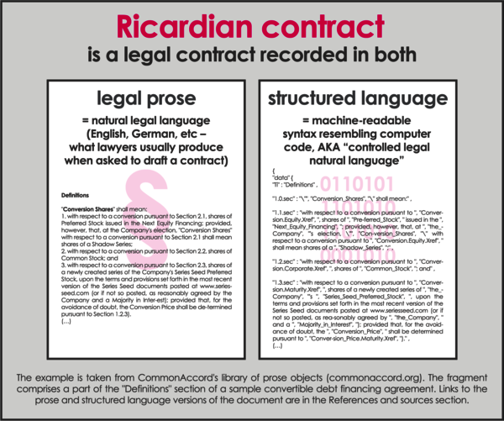
Ricardian Contract Socially Binding Digital Twin

Slide 30
Context: Describe the Spatial and Temporal boundaries of the project.
Abstract Specification
Goal: Mission Statement written in an imperative sentence with reference to “Context”.
Measurable Effects: Conditional statements of the observable implementation outcomes that satisfy the “Goal”.
Concrete Implementation Process
Outputs
A list of noun phrases that declares the deliverable items from proposed activities
Activities
A structured set of actions that depicts implementation activities.
Ideally written in a formalized process specification language
Inputs
Prescribe the required resources to be consumed in the implementation Process
Boundary Conditions: When and how the boundaries of the previously defined ”Context” could be broken?

Slide 31
Sample Logic Model
Context: A two vessel system containing moving particles of varying speeds.
Abstract Specification
Goal: Let particles moving at speed higher than average to the left vessel, and lower than average particles to the right vessel.
Measurable Effects: Total average speed of all particles, and final distribution of moving particles.
Concrete Implementation Process
Left Vessel
Particles moving about from initial condition to the end of the last action of Maxwell’s Demon
Activities of
Maxwell’s Demon
Right Vessel
Particles moving about from initial condition to the end of the last action of Maxwell’s Demon
Continuously observe the Average Speed of all Particles
Move faster than average particles to the left, and the others to the right
Boundary Conditions: The Maxwell’s Demon’s decision powers can be externally supplied from outside the two vessel system.

Slide 32
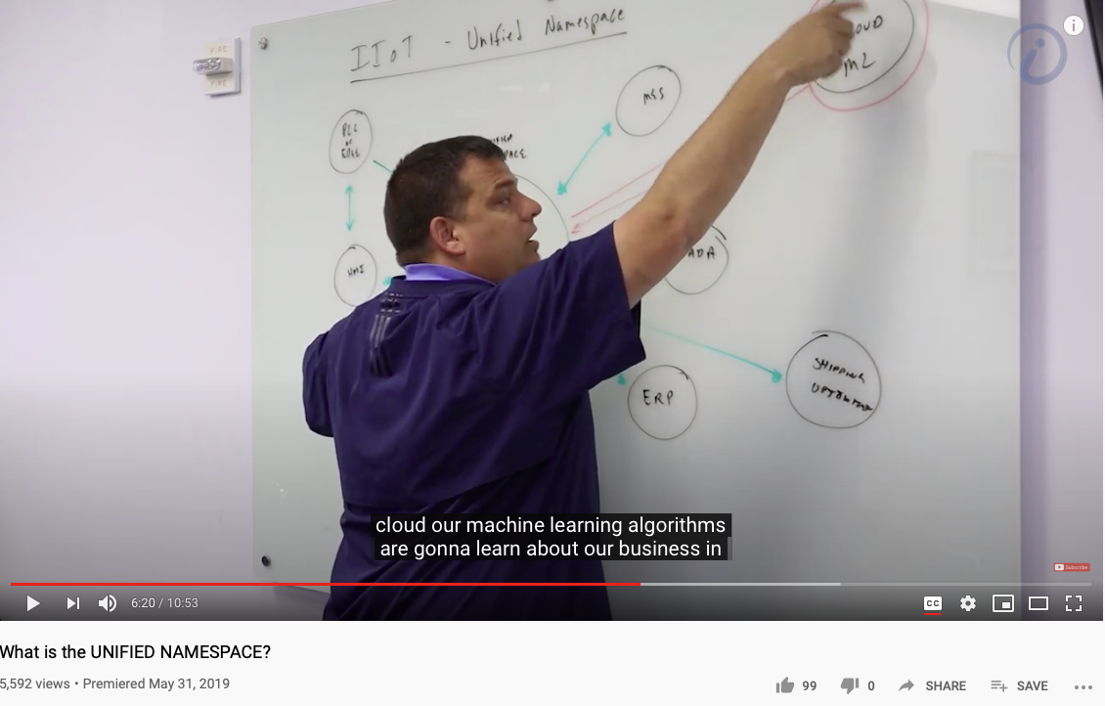
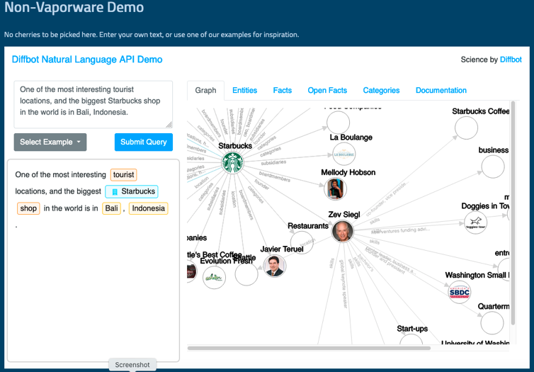
Unified Namespace

Slide 33
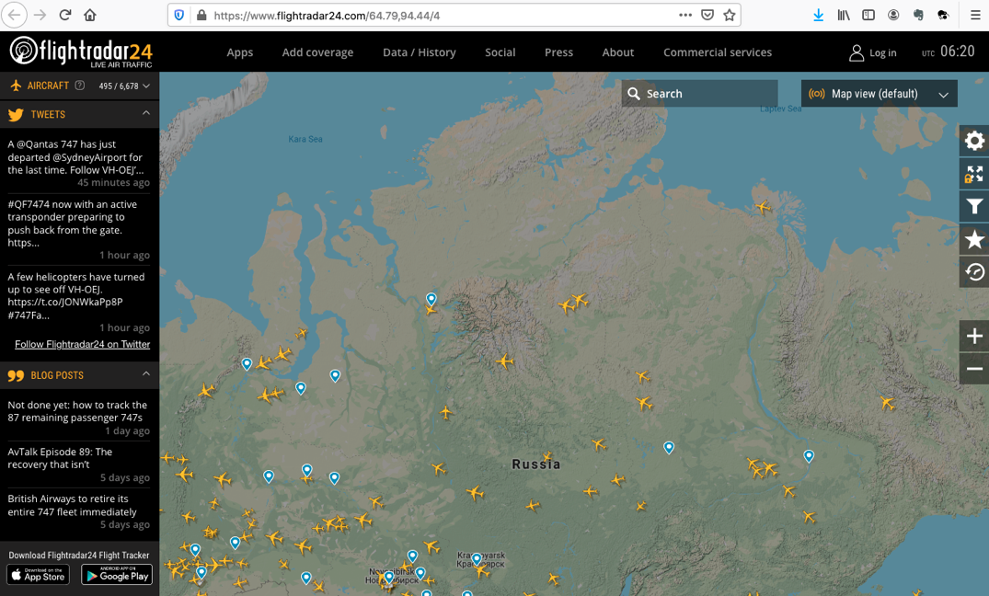
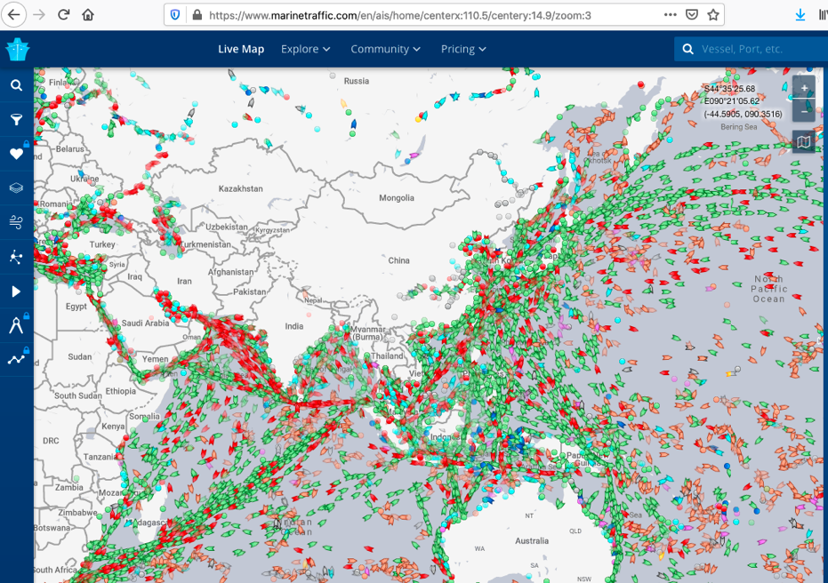
Get access to Live Data Now!
https://www.flightradar24.com/
https://www.marinetraffic.com/

Slide 34


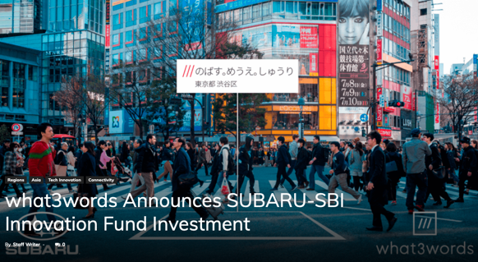
An example of Namespace Management

Slide 35
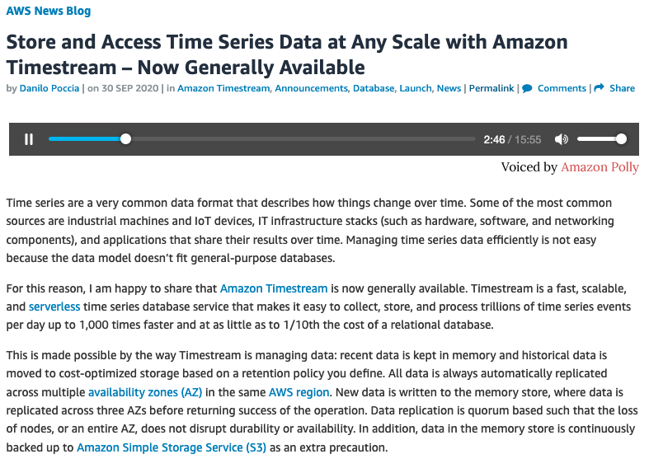
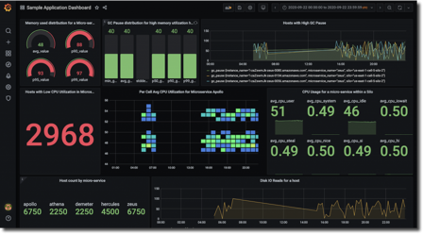
Namespace Management in Time

Slide 36
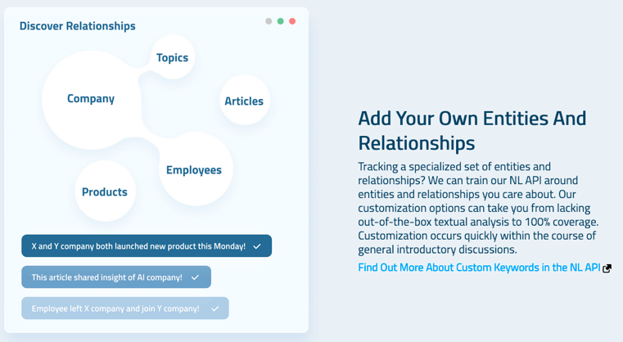
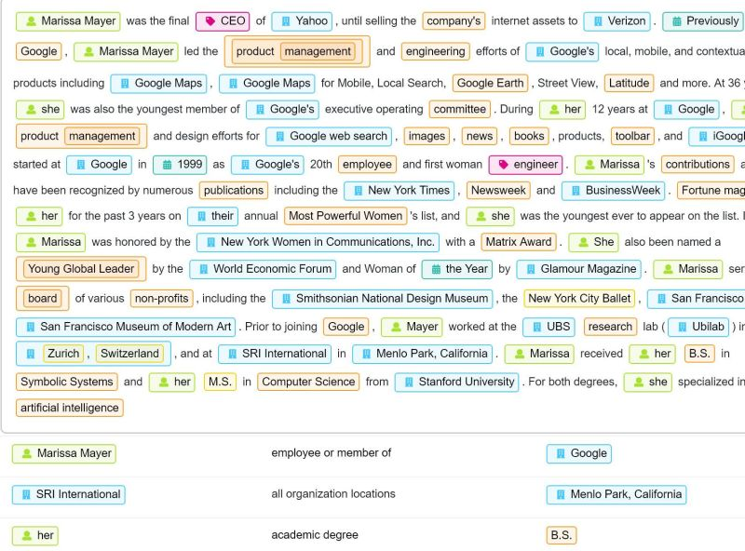

Diffbot (more than 1 Trillion linked entities)

Slide 37
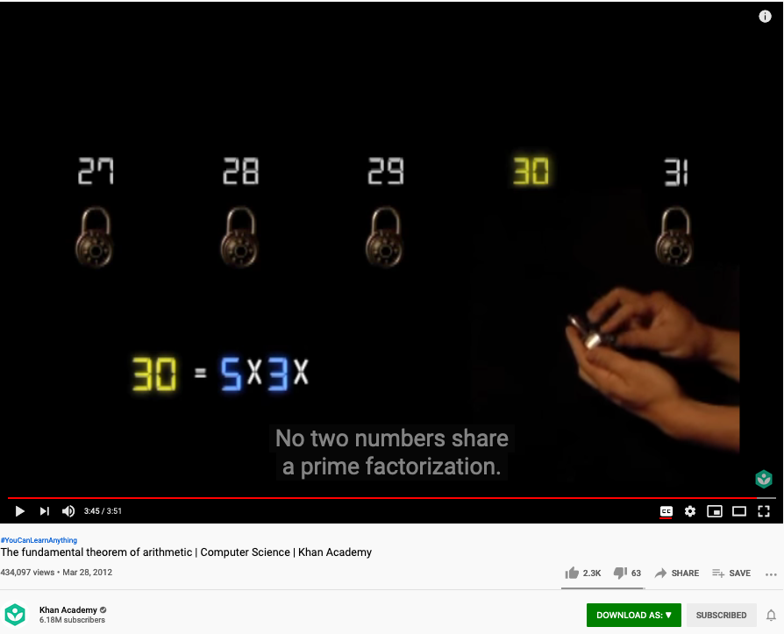
The Fundamental Theorem of Arithmetic (Name Space Management Trick)
Huawei VP Mr. Yang Shaoqing
https://youtu.be/8CluknrLeys?t=225
The fundamental theorem of arithmetic | Computer Science | Khan Academy

Slide 38
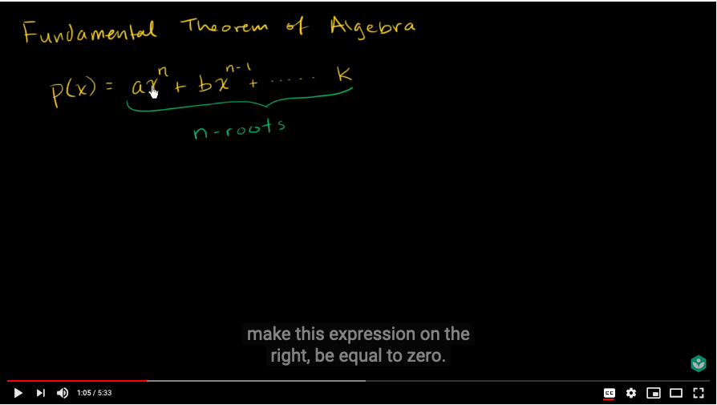
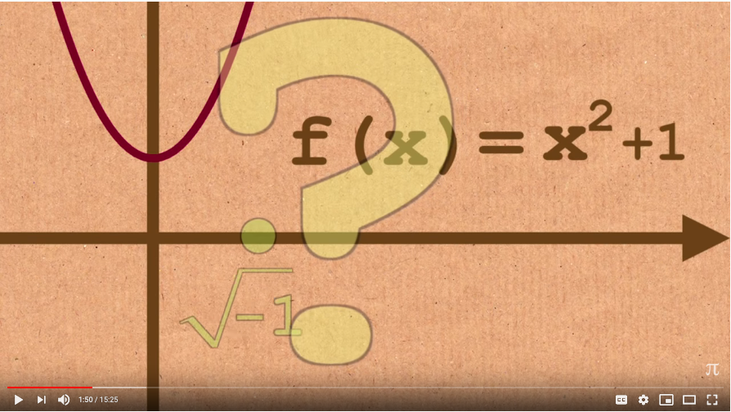
The Fundamental Theorem of Algebra
Huawei VP Mr. Yang Shaoqing
https://youtu.be/d8-LO6FCna0?t=65
https://youtu.be/shEk8sz1oOw?t=110
Fundamental theorem of algebra | Khan Academy
Fundamental Theorem of Algebra - Numberphile

Slide 39
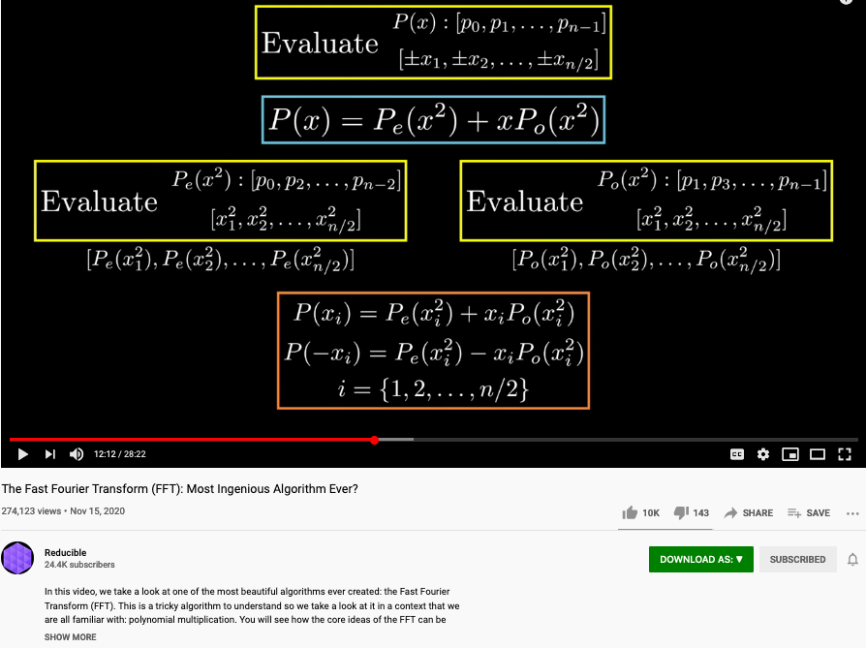
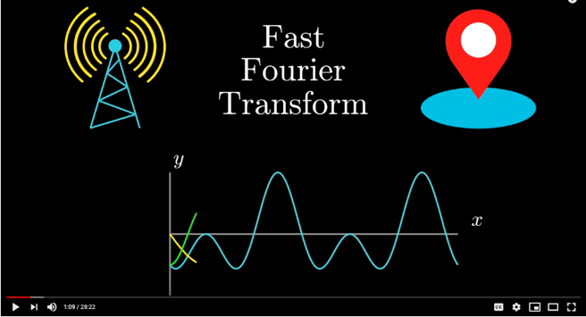
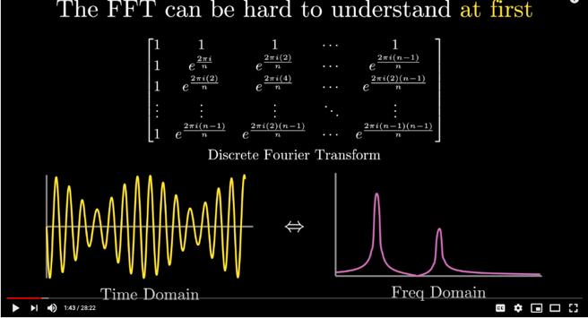
The Polynomial that appears in Fast Fourier Transform
Huawei VP Mr. Yang Shaoqing
https://youtu.be/h7apO7q16V0?t=732

Slide 40
What is the minimum Symbol Space?
Huawei VP Mr. Yang Shaoqing

Slide 41
Is binary valued system the smallest symbol set?
Huawei VP Mr. Yang Shaoqing

Slide 42
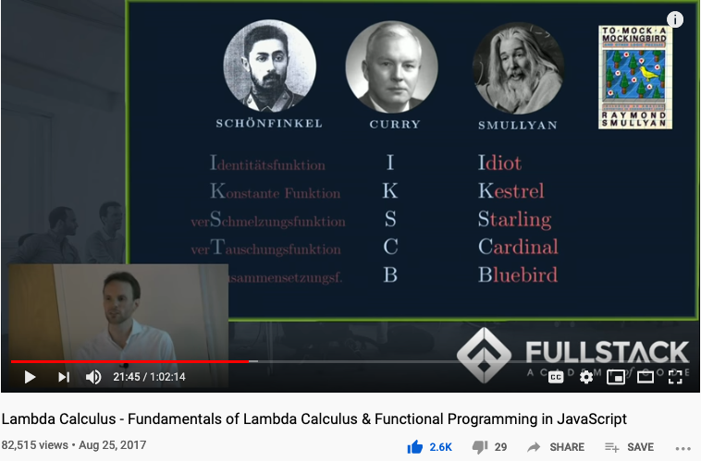
Computable Logic and Types of “Birds”

Slide 43
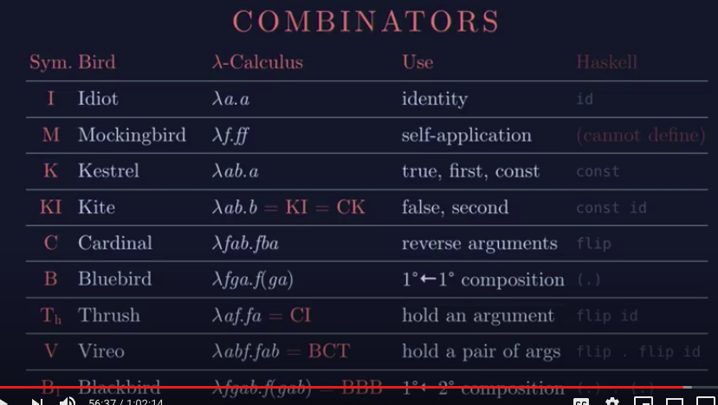
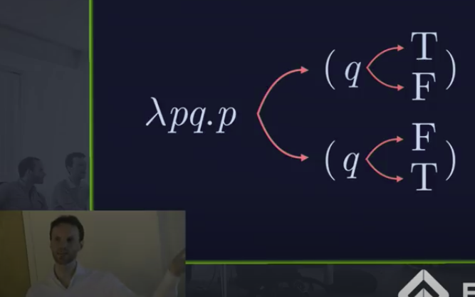
The Names of Birds (Functions)

Slide 44
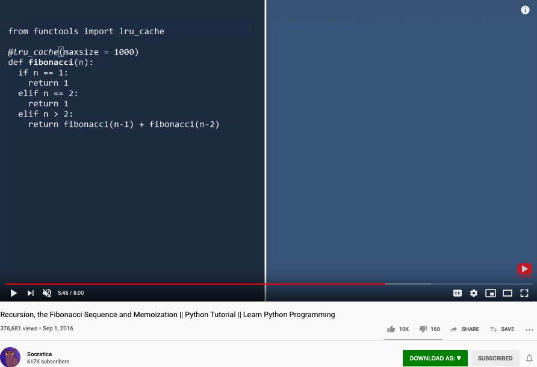
Memoization
An important technique to manage names dynamically!

Slide 45
Maybe we should teach Math in a different sequence
The notion of Pureness
Approximation to Idealized Truth
A curriculum modeled after
Curry-Howard-Lambek Correspondence

Slide 46
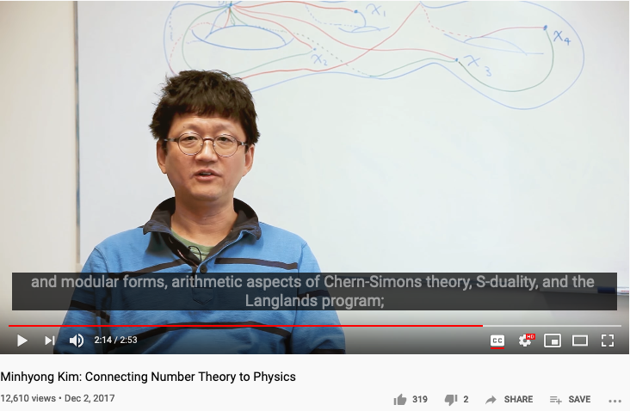
Number Theory, Physics, and Geometry
Huawei VP Mr. Yang Shaoqing
RICH 70 Tsinghua SEA Cloud Forum, Sep 14, 2020
H. E. Bambang Brodjonegoro,
Minister of Research & Technology, Indonesia
Ninhyong Kim has been a research professor of number theory at the University of Oxford and the head of their number theory research group.

Slide 47
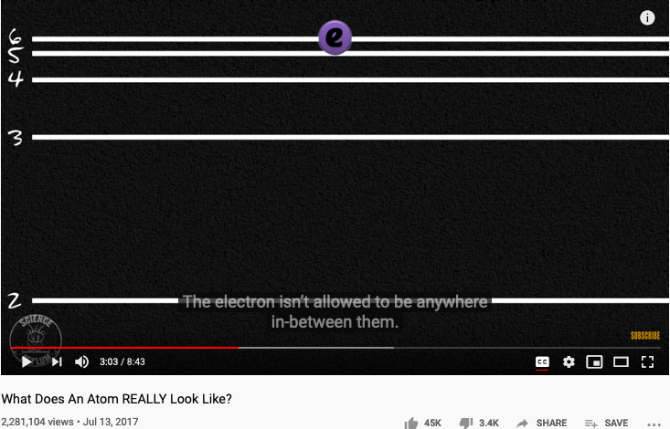
The origin of Atomic Elements
Huawei VP Mr. Yang Shaoqing
RICH 70 Tsinghua SEA Cloud Forum, Sep 14, 2020
H. E. Bambang Brodjonegoro,
Minister of Research & Technology, Indonesia

Slide 48


The known set of Elementary Particles
Huawei VP Mr. Yang Shaoqing
RICH 70 Tsinghua SEA Cloud Forum, Sep 14, 2020
H. E. Bambang Brodjonegoro,
Minister of Research & Technology, Indonesia

Slide 49

The way medical doctors talks about Human Anatomy
Huawei VP Mr. Yang Shaoqing

Slide 50


How mathematicians and musicians “talks” about Music
Huawei VP Mr. Yang Shaoqing
RICH 70 Tsinghua SEA Cloud Forum, Sep 14, 2020
H. E. Bambang Brodjonegoro,
Minister of Research & Technology, Indonesia

Slide 51



How math-musicians “talks” about Music
Huawei VP Mr. Yang Shaoqing
RICH 70 Tsinghua SEA Cloud Forum, Sep 14, 2020
H. E. Bambang Brodjonegoro,
Minister of Research & Technology, Indonesia
More information about this series: https://www.springer.com/series/8349

Slide 52

A Way to Get Internet Domain Name Service
Huawei VP Mr. Yang Shaoqing

Slide 53


NsM in Loops and Recursion

Slide 54


Another Round at Recursion

Slide 55


Namespace at Scale
GPT-3 A very large vocabulary to date
An earlier industrialized computable vocabulary
175 Billion Parameters

Slide 56

First Approximation If there are called the same name, they must be equal.
For example …

Slide 57

Definitional Suggestion for Computing Science

Slide 58





The man who redefined Equal in Math!
By Kevin Hartnett
Vladimir Voevodsky

Slide 59

Review the history of Algebraic Topology
Prof. Pierre Albin

Slide 60

The foundation of math as programming languages
Prof. Robert Harper

Slide 61


Memoization: Remember Generated Names

Slide 62

Lecture Outline

Slide 63


The Meaning of being True
Huawei VP Mr. Yang Shaoqing
RICH 70 Tsinghua SEA Cloud Forum, Sep 14, 2020
H. E. Bambang Brodjonegoro,
Minister of Research & Technology, Indonesia
Russel once said: “Mathematicians’ job is about classifiying.”
Mathematics is the art of giving the same name to different things.^{[10]} Henri Poincaré

Slide 64


The Necessity of Named abstractions
Huawei VP Mr. Yang Shaoqing
Through abstraction, only compute truth within the domain of interest!
So that it can by pass the Halting Problem.

Slide 65

How to Think Mathematically?
Huawei VP Mr. Yang Shaoqing
RICH 70 Tsinghua SEA Cloud Forum, Sep 14, 2020
H. E. Bambang Brodjonegoro,
Minister of Research & Technology, Indonesia
Russel once said: “Mathematicians’ job is about classifiying.”
Mathematics is the art of giving the same name to different things.^{[10]} Henri Poincaré

Slide 66

True Name defined by Wikipedia

Slide 67




The Book of Why

Slide 68
What, How and Why
What/Association marks data content (naming objects)
How/Intervention demonstrates active intent (human free will)
Why/Counterfactuals checks on associations by breaking symmetry
Branching on the assumptions/contextual groundings
It is the simplicity of data types (associations) that enables scale
All data types share the same basic type (association/arrow/label/named object)

Slide 69
The Universal Structure in 𝜆-Calculus Form
Expression := Contextualized Data (* Known interpretation results, no computation *)
| Goal_Exp Criteria_Exp (* Timeless and Time-based expressions *)
| 𝜆 Input Output_Exp(Input) (* A Computing Process *)
| ( Exception_Handling ) (* Stated boundary conditions/Exceptions *)
This set of rules can be used recursively to generate an infinite amount of expressions.
What
Contextualized data
Goal Expr
Criteria Expr
Why
𝜆
Input
Output Spec
How
( )
Exception Handling

Slide 70

Intensive and Extensive Properties

Slide 71




Labels, Linguistics, and Cognitive Science
Image Source: https://georgelakoff.com/

Slide 72



The expressive power of Names (labels)
Huawei VP Mr. Yang Shaoqing
Prof. George Lakoff

Slide 73

Namespaces as pure abstractions
Video Source: https://youtu.be/TbNymweHW4E?t=246

Slide 74

Categories are Containers of cognitive concepts
Huawei VP Mr. Yang Shaoqing

Slide 75

Patterns of Categories/Classification of Concepts
Grounded Ideas:
Adding (+): including objects into a collection
Subtraction (-): taking objects away from the collection
Sets: containers of elements
Abstract Ideas:
Numbers as points on a line
Geometrical figures as algebraic equations

Slide 76




Combine Operands/Operations as constructed names?
Cayley Table

Slide 77


Names as Generalized Metaphors
Huawei VP Mr. Yang Shaoqing
RICH 70 Tsinghua SEA Cloud Forum, Sep 14, 2020
H. E. Bambang Brodjonegoro,
Minister of Research & Technology, Indonesia

Slide 78


The properties of being Trust-worthy name schemes
Soundness:
All names refer to at least one legal entity
Completeness:
All legal entities must all have at least one name
Controlled Access Rights
Non-repudiation:
Every name only points to one unique legal entity
Tamper-Proof:
Authorized entities can make changes
Any change to the name system must become public knowledge
Time-based:
All name changes should be time-stamped by one coherent clock
Huawei VP Mr. Yang Shaoqing
RICH 70 Tsinghua SEA Cloud Forum, Sep 14, 2020
H. E. Bambang Brodjonegoro,
Minister of Research & Technology, Indonesia

Slide 79



“Mathematics is the art of giving the same name to different things!” - Henry Poincare

Slide 80

How to cope with Infinite Number of Namespaces? Category Theory to the rescue
https://youtu.be/UKIoiO9CSXU?t=341

Slide 81
How do you know that you know?

Slide 82


Methods and Tools
MediaWiki as a Tool
Data in MediaWiki/Wikipedia
Templates and Categories
Structures and Strategies in Namespace Management

Slide 83
Time and Trust-worthiness in NsM
All Name Spaces should share a universal “clock”
The common “Historical-Trail” (time-based) of Name Spaces
So that the time-stamps would offer hints to cross-check “causal” consistency
Name Spaces should be extensible
It should follow one consistent naming convention for easy referencing
Kuhn’s Cycle provides a Generative/Cyclic Model
Name Space Authentication should be scalable and distributed
Existing mechanisms for authenticated name registration, i.e. Domain Name Services (DNS).

Slide 84

Trust-worthy Name Space?
Competence:
What can you deliver?
Reliability:
Success rate of delivery?
Integirty:
Will you ever cheat me?
Empathy:
Are you on my side?
Being More Trustworthy: The Basics
― Rachel Botsman, Jan 14, 2019

Slide 85

Authenticated Name Space?
Digital Authentication - the basics
― Dawn M. Turner (guest) on 01. August 2016

Slide 86


Public-Private Key NsM Infrastructures
The paper that changed
the direction of NsM!
What is Private Key Infrastructure?

Slide 87



Naming your Learning Actions

Slide 88


Operational Concerns
Access Rights
Editorial Decisions
Process Management
Image source: https://www.keeprunning.io/2019/09/24/workload-identity-config-connector/
Production Workflow of
Namespace Management

Slide 89

Access Rights and Secure Workflow
What is DevSecOps?
Image courtesy: Paladion Corporation Website Image source: https://www.paladion.net

Slide 90

What is DevSecOps?

Slide 91






A Model of Collective Cognitive Processes
(students/teachers)
(Smart) Social Contract Execution
Traders
Miners
Coders
(Consumers/Distributors)
Three Asynchronous
Clocks in their respective
Communities
Version Upgrade
Production Code
Function Requests
Customer Crisis
Feature Revolution
Emerging cases or
systematic attacks
(Artists/Creative Projects)
(Administrators/Witnesses)
Perform Checking
receive confirmation
commit transaction
(Content Producers/Product Designers)
(Accountants/Lawyers)

Slide 92


Kuhn Cycle: the evolution of a Namespace
Normal Science
Model
Drift
Model Crisis
Model Revolution
Paradigm
Change
Emerging cases or
systematic attacks
Product Development Process
in five stages
Commit
Build
Test
Stage
Deploy
Unknown/incompatible names introduces crisis. (incommensurability).

Slide 93


Reserved Names and Constants in Sciences
Unzicker’s Observations:
Revolutions in physics have always eliminated arbitrary numbers
A complete theory of reality must do without any constants of nature
https://youtu.be/zxAV_Re4OWA?t=239
https://youtu.be/zxAV_Re4OWA?t=323
On the origin of constants C and h, by Alexander Unzicker, last accessed Oct 20, 2020

Slide 94
Decisions are made by different kinds of People
Traders
（students/teachers）
Miners
（Administrators/Witnesses）
Coders
(Artists/Creative People)
(Consumers/Distributors)
(Content Producers/Product Designers)
(Accountants/Lawyers)

Slide 95


Observability of Multi-Scale DevSecOps Processes
Traders
（students/teachers）
Miners
（Administrators/Witnesses）
Coders
(Artists/Creative People)
Sec
Consumers/
Distributors
Dev
Ops
Content Producers/
Product Designers
Accountants/
Notary Service Provider

Slide 96

Metrics of “Namespace Services”
https://www.getambassador.io/products/

Slide 97


A Unified Namespace
What are representables?
A Portal to all Names
Human-Machine Interface
Physical and Information Sciences shares the same Challenge

Slide 98








A linguistic approach to unify the cognizance across scales
Namespace = Cognitive Space

Slide 99



Code is Law

Slide 100

A Unified Context for the Collective Cognizance
Far
Space
near
before Time after

Slide 101


Three Scales of Time
Mesoscopic：
Localized Adjustments
Time Stamp
Macroscopic:
Five Stages of Evolution
Normal Science
(commit)
Model
Drift
(build)
Model Crisis
(test)
Model Revolution
(stage)
Paradigm Change
(deploy)
Microscopic：
Process Data and Summative Result
Time Stamp

Slide 102
Time Stamped Data Preserve Event Ordering Information
Normal Science
(commit)
Model
Drift
(build)
Model Crisis
(test)
Model Revolution
(stage)
Paradigm Change
(deploy)
Time Stamp
Time Stamp
Time Stamp
Time Stamp

Slide 103

ITIL’s Introductory Video
ITIL Funadmentals shown in five stages

Slide 104


ITIL’s Five Stages of Service Deployment
Image Source: ITIL for Dummies P.39
Image Source: ITIL for Dummies P.45
The Cabinet Office refers to UK’s Cabinet.
ITIL Funadmentals shown in five stages

Slide 105

The Five stages mapped to ITIL terms
The Cabinet Office refers to UK’s Cabinet.
Image Source: ITIL for Dummies P.45
Strategy Formation
(commit to a strategy)
Designing a new Model
(build)
Transition
(test against potential crisis)
Trial Service Operations
(stage)
Continuous Improvement
(deploy)
Time Stamp
Time Stamp
Time Stamp
Time Stamp

Slide 106


The Five stages mapped to ITIL terms
Image Source: ITIL for Dummies P.226
The Cabinet Office refers to UK’s Cabinet.
Strategy Formation
(commit to a strategy)
Designing a new Model
(build)
Transition
(test against potential crisis)
Trial Service Operations
(stage)
Continuous Improvement
(deploy)
Time Stamp
Time Stamp
Time Stamp
Time Stamp

Slide 107

What is CICD and DevOps? Continuous Integration, Continuous Delivery/Deployment
Image courtesy: Peter Change on Hackernoon

Slide 108
Financial Accounting Process
Source Document
Journal entries in Journals
Post entries to ledger
Trial Balance
Financial Statement
Time Stamp
Time Stamp
Time Stamp
Time Stamp

Slide 109

System Integration Process
Image courtesy: Learn How to Set Up a CI/CD Pipeline From Scratch on DevOps Zone

Slide 110
Iteratively Fixing Security Problems
Technology Integration
Technology
Society
Security
Technology
Security
Society
Technology Isolation
Modified from Figure 1-1 and 1-2 of Agile Application Security: Enabling Security in a Continuous Deliver Pipeline,
by Laura Bell, Michael Brunton-Spall, Rich Smith & Jim Bird, O’Reilly Media, 2017

Slide 111



The Version Control, Built, Test, Stage, Deploy are Conducted by Human Instructions
Image courtesy: Learn How to Set Up a CI/CD Pipeline From Scratch on DevOps Zone

Slide 112
A compositional view of system correctness
Liveness
Safety
Correctness
The Theoretical Definition of System Correctness
Correctness = Liveness ∧ Safety
Liveness: Something good eventually happens
Safety: Nothing bad ever happens

Slide 113

The Commit-Built-Test-Stage-Deploy are Fully Automated
Image courtesy: Learn How to Set Up a CI/CD Pipeline From Scratch from DevOps Zone

Slide 114
Continuously Adjust the Correctness Area
Liveness
Safety
Correctness
The Inremental Change Approach promoted by DevOps/CICD practitioners

Slide 115

Automation approximates and enables Process Continuity
Image courtesy: Learn How to Set Up a CI/CD Pipeline From Scratch from DevOps Zone

Slide 116

What is DevOps? Development and Operations
Image courtesy: Riyaz Hyder on Botmetric November 2, 2017

Slide 117

Not Information Asymmetry, but promote the Principle of Information Symmetry

Slide 118

Open and then Free
Open Source
Right to use publicly available technologies and other resources in the learning process
Right to resolve conflicts in a dynamic context in digitized space
Freedom to make decisions related to one’s personal digital assets
Freedom to express one’s opinions
Free Software
Founder of Free Software Foundation, and Creator of GNU/Linux. Image credit: Wikipedia
Paraphrased from “Free Software, Free Society” by Richard Stallman

Slide 119


Service Mesh (Istio) and Human Physiology Checks and Balances Data Plane and the Control Plane
Data Plane
Control Plane
Data Plane
Control Plane

Slide 120

Awareness at many levels

Slide 121
Governance in Cyber-Physical Spaces
John Locke’s Theory of Governance
All Men(Persons) are Created Equal
Certain Basic Rights Exists Independent of Government
Government Exists to Protect those Rights
Cyberspace Governance
All User Accounts can be Equally Created
Users may do anything Independent of Cyber-Government
Cyber-Government exists to enable user rights without Breaking the Cyber-Physical System
System Engineering | John Locke | Cyberspace
Correctness | All Men are Created Equal | All Accounts are Created Equal
Liveness | Certain Basic Rights exists Independent of Government | User actions are Independnet of Cyber Governance
Safety | Government exists to Protect those Rights | Cybersecurity exists to prevent users break the System

Slide 122







DevOps for Smart Cities

Slide 123

DevOps Goals for Governance
Notes:
1. 對稱性是底層的不變性
2. 在Cyberspace上，數據、操作數據的方式、操作數據的基礎架構，是資產的根本
3. 邏輯模型是凝聚群體意識的有效框架
4. Devops 能夠高效實現不同規模的Logic Model, 藉由（不同層次）數據可視與可控

Slide 124




Cyber-Physical Space Integration
Public Domain Data
Smart Contract Data
Private
Data
Notes:
1. 對稱性是底層的不變性
2. 在Cyberspace上，數據、操作數據的方式、操作數據的基礎架構，是資產的根本
3. 邏輯模型是凝聚群體意識的有效框架
4. Devops 能夠高效實現不同規模的Logic Model, 藉由（不同層次）數據可視與可控

Slide 125


The CAP Theorem in NsM
RICH 70 Tsinghua SEA Cloud Forum, Sep 14, 2020
H. E. Bambang Brodjonegoro,
Minister of Research & Technology, Indonesia

Slide 126



Name Spaces in Databases
RICH 70 Tsinghua SEA Cloud Forum, Sep 14, 2020
H. E. Bambang Brodjonegoro,
Minister of Research & Technology, Indonesia

Slide 127





We are in the Universe, now!
Library of
Linked Knowledge
(Data Plane)
Library of Executable Algorithms
(Control Plane)

Slide 128







Abundant Tools and Data Sources can all be accessed through Web Browsers

Slide 129
Namespace Management operated under the Principle of Information Symmetry
Natural & Structural Symmetry: Space, Time, Energy
Data Content Symmetry: Immutable Data Service
Functional Symmetry: Algorithmic Consistency
Infrastructure Symmetry: Trust-worthy System Support
Knowledge Symmetry: Equality in Information Interpretation
Notes:
1. 對稱性是底層的不變性
2. 在Cyberspace上，數據、操作數據的方式、操作數據的基礎架構，是資產的根本
3. 邏輯模型是凝聚群體意識的有效框架
4. Devops 能夠高效實現不同規模的Logic Model, 藉由（不同層次）數據可視與可控

Slide 130

Discussion and Future Applications
Past Known efforts
Alternative Strategies?
Other Applications?
Round Table Discussion

Slide 131
Knowledge Management in NsM
Poincare: Math=art of naming different things with the same name.
With lambda calculus, Namespace can be computable
Very large scale name space can be organized by Machines
Through computing machinery, one may trade storage space with time
NsM can bring unprecedented utility to many fields of applications
A different way to look at computable abstractions
Computational abstractions can be reduced down to NsM
Space-time-energy can be unified in the namespace of structured operations

Slide 132

Lets go back to the birth place of the World Wide Web!
Conclusion
Far
Space
near
It is all made of Names!
before Time after

Slide 133
Students Actions before Wednesday Sep 18, 2021
Register on toyhouse.wiki:81 with an account
Create a personal page with bio
Create a link in the personal page to your weekly learning report
Learn to use Mediawiki’s Hyperlink, Page/Template Transclusion, and Category features
Start writing your learning report.
Every week should include a Logic Model (apply Logic Model template)
500 words or more per week

Slide 134



Metaphors make up the Foundation of Cognition
https://youtu.be/n8m7lFQ3njk

Slide 135



The Learnability Hypothesis by Leslie Valiant
The machines can provably learn whole classes of concepts. Furthermore these classes can be characterized.
The classes of concepts are appropriate and nontrivial for general purpose knowledge,
The computational process by which the machines deduce the desired programs requires a feasible (i.e. polynomial) number of steps.
Turing Award (2010)
Communications of the ACM. 27 (11): 1134–1142. doi:10.1145/1968.1972

Slide 136
Computationally-Enhanced Cognitive Foundation Transcending the Boundaries of Human, Machines, and Knowledge Disciplines
Huawei VP Mr. Yang Shaoqing

Slide 137
AUDIENCE
Registered Students@THU
A course FOR ALL Disciplines
Fulfills Liberal Arts Req. (通识课)

Slide 138
AUDIENCE (self-intro)
Everyone speak for 120 seconds
Your name
Department Association
Why do you choose this class?
What do you expect to learn?
What is your strongest trait?
Any knowledge related to cognitive science?

Slide 139


Soundness
Completeness
Every provable statement is true
Every true statement is provable
Cited from : Soundness and Completeness: With Precision on news.ycombinator.com
https://youtu.be/3hspKYIn5ds?t=29
https://youtu.be/3hspKYIn5ds?t=162

Slide 140

Course Outline

Slide 141


“Modern” Cognitive Science
Is there a finite set of actions to verify the existence of self?
Is there a “universal grammar” that is applicable to all?
https://www.openculture.com/2019/02/a-brief-animated-introduction-to-noam-chomskys-linguistic-theory-narrated-by-the-x-files-gillian-anderson.html

Slide 142















From History, Logic, Philosophy, Math, Physics, to Computation, Communication, Control, and Society
Huawei VP Mr. Yang Shaoqing
Per Martin-Lof
Leslie Lamport, 2013 Turing Award, Distribute Systems and Temporal Logic
Saunders Mac Lane

Slide 143
What are the formal foundations?
Formalized Languages, “Universal, Abstract Grammars”
Fundamental Theorems of Arithmetic, Algebra, and Calculus
The notion of Equivalence: As defined by Voevodsky’s Univalent Foundation
Category Theory Foundation: Universal Properties and Homotopy Type Theory
Intuitive Nomenclatures
We understand the world by assigning proper names in convenient formats (Logic Model)
Application-specific controlling, computing, and communicating mechanisms (Cybernetics)

Slide 144

Logic Model (OKRs) as a Transdisciplinary Foundation

Slide 145

Objective & Key Results (OKRs)
Objectives
A statement of a broad goal,
Usually qualitative in nature.
Key Results
A statement that measures
Achievement of a given objective

Slide 146
Abstraction
Concretization
Why is abstraction useful?
Allow reuse through universal properties
Avoid resource conflicts
Scale free and domain neutral
Generalizing concrete experience?
Make analogies in localized contexts
Engage sensible metaphors
Define terms and boundaries
A well-defined set of Actions and iterative Branching Strategies
A Roadmap of composable activities
Sequencing and timing conditions
Explicitly state dependencies and resource requirements
Namespace Management

Slide 147



Reference Materials on OKRs

Slide 148
Context: Describe the Spatial and Temporal boundaries of the project.
Contextualized Objectives
Goal: Mission Statement written in an imperative sentence with reference to “Context”.
Success Criteria: Conditional statements of the implementation outcomes that satisfy the “Goal”.
Concrete Implementation Process
Process that Delivers Key Results
Outputs
A list of noun phrases that declares the deliverable items from proposed activities
Activities
A structured set of actions that depicts implementation activities.
Ideally written in a formalized process specification language
Outputs
A list of noun phrases that declares the deliverable items from proposed activities
Activities
A structured set of actions that depicts implementation activities.
Ideally written in a formalized process specification language
Inputs
Prescribe the required resources to be consumed in the implementation Process
Inputs
Prescribe the required resources to be consumed in the implementation Process
Boundary Conditions: When and how the boundaries of the previously defined ”Context” could be broken?

Slide 149


Context: Modern Technologies challenges the cognitive capacities of human and human societies.
Goal: Provide a methodical cognitive framework to leverage contemporary technologies and cognitive science content.
Success Criteria: Enable students to utilize cognitive methods and tools, while measuring learning outcomes accordingly.
Outputs
Cognitive Science Report
Summarize your methods
Digitally published Learning Reports
Behavioral Data (on MediaWiki)
Personally chosen application areas
Biology, Physics, Math, Literature, Social Science, Arts, …
Activated Processes
1. Course Preparation
Content and Process design
2. Learning Program Execution
16 week exercise
3. Program Refinement
Continuous Adjustments
Periodic Refinements
Inputs
Curricular Structure
Coherent with university-level curriculum design
Content Data
A time-oriented knowledge(data) representation framework
Meta Data Formats
Logic Model(OKRS), Learning Report Format, Universal Resource Locators
Boundary Conditions: Personal willingness to adopt a new cognitive foundation, and intensity of practicing this new skill

Slide 150


Introduce Balanced Strategy Map (BSM) by Kristy Wong A new kind of Logic Model & a variant of OKRs (Spring 2020)

Slide 151





A course that invite you to investigate THINKING at multiple scales create and publish your own ideas in a digital publishing workflow…

Slide 152



2018 International Summer Program @ Tsinghua Experience a publishing workflow using DevOps

Slide 153

Measurements in Context
Spacetime as the foundational metrics
A statement that outlines the perimeter of project concern
Focus on contemporary situations that are most critical in directing and justifying certain goals
Remind yourself about the relevancy of potential actions
For a semester long course, plan for actions that can be finished in a few months.
Identify a desired scope of your cognitive actions ...
Image source:
Ask Ethan: Is Spacetime Really A Fabric?

Slide 154

What makes a Sound method?
A natural equivalence that is
up-to-isomorphism to relevant domains.
A method that matches your application context,
without the losing scope of possible alternatives.
Henri Poincare is main figure in modern topology and physics in general.

Slide 155

How to measure with generality?
An important foundation in quantitative measurements!

Slide 156


Universality in Textbook

Slide 157




Incompleteness Theorem: Limits of Math/Logic
Image source: newyorker.com
https://youtu.be/V9ohtKameio

Slide 158

CONTEXT that Narrows your scope of Objectives
GLOBALIZATION AND INDUSTRIALIZATION CHALLENGED THE BOUNDARY OF HUMAN COGNITIVE POWERS
THE SPEED OF CHANGES EXCEEDS MENTAL CAPACITY
Societal Implosion & Globalized Chaos
Incoherent minds and body
overwhelmed by new knowledge
lost of self-worth

Slide 159




Speed is the Dominant factor in Decision Making
A NEW Cognitive Foundation is needed to enable
Sufficiently FAST
collective learning!

Slide 160

Power of a Dominant Design/Protocol
“Theoretical framework: dominant category and dominant design during the industry life cycle. During the industry life cycle, the number of categories will increase before the number of firms increases. The emergence of the dominant category occurs as the number of categories begins to decrease. This point in time marks the opening of the window of opportunity for entry, whereas the emergence of the dominant design marks the closing of the window of opportunity”
Excerpt from the article:
Perfect timing? Dominant category, dominant design, and the window of opportunity for firm entry

Slide 161





The World has changed … Ways to conduct business have changed …
https://en.wikipedia.org/wiki/George_Hotz

Slide 162

Kuhn Cycle: as the ticking clock
Normal Science
Model
Drift
Model Crisis
Model Revolution
Paradigm
Change
Emerging cases or
systematic attacks
Product Development Process
in five stages
Commit
Build
Test
Stage
Deploy

Slide 163
Learning Outcome: A Namespace Management Methodology
Normal Science
Model
Drift
Model Crisis
Model Revolution
Paradigm
Change
Emerging cases or
systematic attacks

Slide 164

Three Scales of Time
Mesoscopic：
Localized Adjustments
Time Stamp
Macroscopic:
Five Stages of Evolution
Normal Science
(commit)
Model
Drift
(build)
Model Crisis
(test)
Model Revolution
(stage)
Paradigm Change
(deploy)
Microscopic：
Process Data and Summative Result
Time Stamp

Slide 165
Time Stamped Data Preserve Event Ordering Information
Normal Science
(commit)
Model
Drift
(build)
Model Crisis
(test)
Model Revolution
(stage)
Paradigm Change
(deploy)
Time Stamp
Time Stamp
Time Stamp
Time Stamp

Slide 166

Blockchain, Distributed Ledger Technologies: Time is Money
https://www.investopedia.com/terms/b/blockchain.asp

Slide 167






A Model of Collective Cognitive Processes
(students/teachers)
(Smart) Social Contract Execution
Traders
Miners
Coders
(Consumers/Distributors)
Three Asynchronous
Clocks in their respective
Communities
Version Upgrade
Production Code
Function Requests
Customer Crisis
Feature Revolution
Emerging cases or
systematic attacks
(Artists/Creative Projects)
(Administrators/Witnesses)
Perform Checking
receive confirmation
commit transaction
(Content Producers/Product Designers)
(Accountants/Lawyers)

Slide 168

Smart Contract with Observable Historical Data
ISDA: International Swaps and Derivatives Association

Slide 169



Legal Algorithms: Code is Law

Slide 170
Learning Process as a Publishing Workflow
Traders
（students/teachers）
Miners
（Administrators/Witnesses）
Coders
(Artists/Creative People)
(Consumers/Distributors)
(Content Producers/Product Designers)
(Accountants/Lawyers)

Slide 171
Learnability of a Multi-Scale DevOps Process
Traders
（students/teachers）
Miners
（Administrators/Witnesses）
Coders
(Artists/Creative People)
Sec
(Consumers/Distributors)
Dev
Ops
(Content Producers/Product Designers)
(Accountants/Lawyers)

Slide 172

Goal
Stating objectives in scope
Use imperative sentence to express intent. Be active!
Draw on forces that are present in the context, align your argument with contextualized information
Preparing a proposition that has concrete and verifiable outcomes
For example: Colonizing human in space…
Identify a desired scope of your cognitive actions ...
Image sources:
Ask Ethan: Is Spacetime Really A Fabric?

Slide 173



GOAL
Introduce students to a domain-independent cognitive science results according to the time-based linguistic framework.
Use of the Natural Units as the core linguistic elements
A Social Contract(OKRS) for Learner’s self governance
Create a knowledge container for everyone
Capture knowledge using a Mediawiki Database
Compile personal knowledge into a publication

Slide 174

Success Criteria
A set of conditional statements that qualifies the success criteria to achieve the stated goal(s)
Conditional statements that can be judged to yes/no results
Certain success criteria can be measured in terms of degree of success (portions accomplished)
Success measures maybe assessed in terms of Time and Entropy (probability of success) values.

Slide 175
Success Criteria
Elevate Students’ Knowledge Orchestration Strategies up to the level of necessity presented by contemporary industrial complex
A foundational learning strategy that will continue to work as technologies progresses and complexity/entropy increases
Knowing the essence of data management under a dynamic context
Knowing how namespace management strategies and tools can be used to manage any projects (version control)

Slide 176
What would your gain by taking this Course?

Slide 177

Output
Deliverables at the end of Project
A list of deliverables that are encoded in a generally acceptable namespace
Define outputs in precise technical terms, using a scalable namespace management tool, such as MediaWiki
Output content should be marked with time and contributors’ non-repudiable signatures
Image Source: A Blockchain-Based Notarization Service for Biomedical Knowledge Retrieval
https://www.sciencedirect.com/science/article/pii/S2001037018300400

Slide 178



A Strategy to Stretch Cognitive Model
Enabled by modern Data Infrastructures, modern curriculum may
Be constructed by new Methods, Tools and Applications
Cognitive Model Extension

Slide 179


Driven by Linguistic/Cognitive Science
The Methods, Tools and Applications are based on
Linguistic/Cogntive and Computing Sciences
Cognitive Model Extension
“Mathematics is the art of given the same name to different things.”
― Henry Poincare

Slide 180

Representing Knowledge as Domain-Specific Languages (DSL)
Utilizing Computing Science to define
Vocabulary,
Syntactical Rules
Pragmatic Use Cases of the DSLs
Data Content is categorized in terms of
Process(Learner Behavior) Data,
Publishable Data (managed by participants)
Meta Data (formats or content index)

Slide 181


Organized Activities
A well-defined set of Actions and iterative Branching Strategies
A Roadmap of composable activities
Sequencing and timing conditions
Explicitly state dependencies and resource requirements

Slide 182
DevOps/CICD as the general process pattern
Image courtesy: Paladion Corporation Website https://www.paladion.net

Slide 183

Instrumentation of DevOps
Image courtesy: PETSEBAN on NearCoding

Slide 184



GitOps: Git as the Single Source of Truth

Slide 185

A Self-Optimizing Process
A common organizational template for
Learning organizations with tools and
Well-formed data structures
Broadly categorize courses into 3 types
Macro/Meso/Micro-scopic reasoning
All courses can find reusable elements
All programs should have two kinds of
Corrective/adjustment actions.
During/between program executions.

Slide 186
A Cognitive Learning Program that utilizes Contemporary Tools

Slide 187





Inputs for Collective Cognizance
A domain-independent knowledge model (curriculum data) for
learning organizations with data collection tools and
statistical data analysis practices (namespace management)
Knowledge Content Data such as
Biology, Physics/Chemistry, Math/Computing
To be taught in ”schools”.
A consistent format to be shared by all content
publishers in the community.

Slide 188

“Reliable” Inputs: The Rosetta Stone of Cognizance
https://math.ucr.edu/home/baez/rosetta.pdf

Slide 189

Natural Units
https://en.wikipedia.org/wiki/Natural_units

Slide 190


Foundational Building Blocks?
“… we know that the statement that the Planck length is the smallest possible length is on shaky ground. “
- Dr. Don Lincoln
Related paper links provided by Don Lincoln
Don Lincoln article in Fermilab Today: “Planck length, minimal length” https://www.fnal.gov/pub/today/archive/archive_2013/today13-11-01_NutshellReadMore.html
Frank Wilczek’s paper on absolute units http://ctpweb.lns.mit.edu/physics_today/phystoday/Abs_limits388.pdf
Mead and Wilczek’s public conversation http://ctpweb.lns.mit.edu/physics_today/phystoday/Alden-Repsonse323.pdf
Energy conservation in general relativity: John Baez https://math.ucr.edu/home/baez/physics/Relativity/GR/energy_gr.html
Energy conservation in general relativity: Sean Carroll https://www.preposterousuniverse.com/blog/2010/02/22/energy-is-not-conserved/
English Translation link provided by Sabine Hossenfelder
http://backreaction.blogspot.com/2007/07/planck-scale.html

Slide 191


cell structure/functions and operating systems
Image courtesy: Riyaz Hyder on Botmetric November 2, 2017

Slide 192
A metaphorical connection between anatomy and application development process
Image courtesy: Riyaz Hyder on Botmetric November 2, 2017

Slide 193





Use Physiology as a Domain-Specific Example
Image courtesy: Riyaz Hyder on Botmetric November 2, 2017

Slide 194

Prof. Elkhonon Goldberg and the Happy Digital X Project of THU

Slide 195



A metaphorical connection between biology and social sciences

Slide 196
Not Information Asymmetry, but promote the Principle of Information Symmetry

Slide 197
Open and then Free
Open Source
Right to use publicly available technologies and other resources in the learning process
Right to resolve conflicts in a dynamic context in digitized space
Freedom to make decisions related to one’s personal digital assets
Freedom to express one’s opinions
Free Software
Founder of Free Software Foundation, and Creator of GNU/Linux. Image credit: Wikipedia
Paraphrased from “Free Software, Free Society” by Richard Stallman

Slide 198


Human Physiology and Modern Data Infrastructures Checks and Balances
Data Plane
Control Plane
Data Plane
Control Plane

Slide 199
Code is Law

Slide 200

Spacetime Representations for a Collective Conscious
Far
Space
near
before Time after

Slide 201

Kuhn Cycle as a half cycle of DevOps
Normal Operations
Drifting Norms
Operational Crisis
User Revolution
Version Upgrade
Emerging cases or
systematic attacks

Slide 202



A linguistic approach to Transdisciplinary Cognitive foundation

Slide 203

A Smart way to Govern Activities in Space-Time
Transform everything into Data
(Namespace Management)
Ongoing Development
RICH 70 Tsinghua SEA Cloud Forum, Sep 14, 2020
H. E. Bambang Brodjonegoro,
Minister of Research & Technology, Indonesia
Image credits: http://verses.io

Slide 204



Time sensitive data sources
https://news.ycombinator.com/
Image courtesy: Riyaz Hyder on Botmetric November 2, 2017

Slide 205
GitOps: Git as the Single Source of Truth

Slide 206




Proofing Correctness across time scales

Slide 207





Prior Publications by relevant Course Series
Hyperlinks
between
Documents
Digital Asset
Backup/
Tracking/
Exchange

Slide 208




An Open Source Tech in the Making
Library of
Linked Knowledge
(Data Plane)
Library of Executable Algorithms
(Control Plane)

Slide 209

Representing Collective Consciousness based on the Principe of Information Symmetry
Public Domain Data
Contractual Data
Private
Data
Sec
Dev
Ops
Spiritual
Ecological
People
“Language is an organ of perception, not simply a means of communication”
― Julian Jaynes

Slide 210
An example of Namespace Management

Slide 211




Quiz: Our Cognitive Strategy stands on what 3 things?
Sec
Dev
Ops

Slide 212



Our Cognitive Strategy stands on three legs
A Method based on
Linguistic Theory (name management)
Sec
A Tool Stack based on
Continuous Integration and Git/Wiki
Dev
Ops
Applications driven by available data sources,
organized by a domain-independent namespace.

Slide 213
Governance in Cyber-Physical Spaces
John Locke’s Theory of Governance
All Men(Persons) are Created Equal
Certain Basic Rights Exists Independent of Government
Government Exists to Protect those Rights
Cyberspace Governance
All User Accounts can be Equally Created
Users may do anything Independent of Cyber-Government
Cyber-Government exists to enable user rights without Breaking the Cyber-Physical System
System Engineering | John Locke | Cyberspace
Correctness | All Men are Created Equal | All Accounts are Created Equal
Liveness | Certain Basic Rights exists Independent of Government | User actions are Independnet of Cyber Governance
Safety | Government exists to Protect those Rights | Cybersecurity exists to prevent users break the System

Slide 214

Potential Barriers

Slide 215

Abstraction
Concretization
Motivation
Symmetry over all spacetime
Only encode patterns
Self-contained yet Transcendental
Definition
Local context breaks symmetry
Patterns requires cognitive efforts
Influenced by external factors
A well-defined set of Actions and iterative Branching Strategies
A Roadmap of composable activities
Sequencing and timing conditions
Explicitly state dependencies and resource requirements
Namespace Management

Slide 216
Students Actions before Wednesday Sep 18
Register on toyhouse.wiki:81 with an account
Create a personal page with bio
Create a link in the personal page to your weekly learning report
Learn to use Mediawiki’s Hyperlink, Page/Template Transclusion, and Category features
Start writing your learning report.
Every week should include a Logic Model (apply Logic Model template)
500 words or more per week

Slide 217
Your action on NsM before Sep 29, 2021
Start using Templates and Categories on toyhouse.wiki:81
Create a personal page with bio, using standardized Templates and Category
Make sure all Wiki pages you created follow the same Namespace convention
Start using Github to download and share files with proper NsM
Couse Github @ https://github.com/benkoo/CognitiveFoundation2020
Start writing your learning report.
Every week should include Logic Model using the standard Template
500 words or more per week

